Slide 1
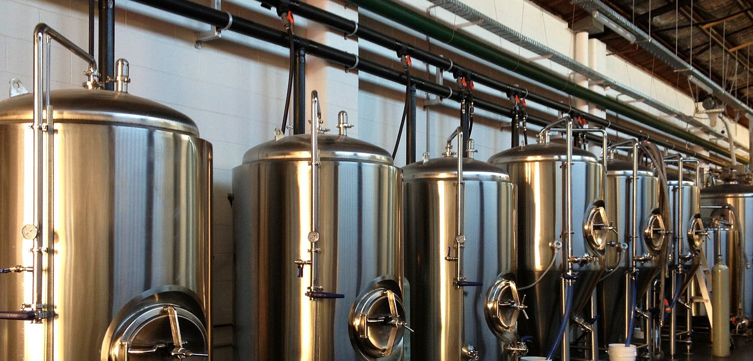

Brewpedia
This Photo by Unknown Author is licensed under CC BY-SA
Data brewers –
Poonam Kushwaha
Renee Gillmore
Bejirose K. Stanly
Ashish Desai

Slide 2
Definitions & Project Scope
Global beer market: $216b
Craft brewery (24% of $114b US beer market)
< 6 million barrels/yr
Less than 25% owned by non-craft brewer
Has TTB.gov Brewer’s notice to make beer
Microbrewery
< 15,000 barrels/yr
Brewpub
Sells 25 percent or more of its beer on-site and operating significant food services
Taproom brewery
Sells 25 percent or more of its beer on-site and does not operate significant food services
Regional Brewery
>15,000 to 6 mill barrels/yr

Slide 3
Hypothesis
Expect IPA to be the most consumed style globally due to the high Alcohol By Volume (ABV) and International Bitterness Unit (IBU)
For this we did the following:
Find brewery counts by country, state, city
Find beer names and types for all those breweries
Find ABV and IBU data for each beer name
Find top beer type for each country
Amount of beer brewed by state vs number of breweries

Slide 4

Data Sources
Ashish
https://googles.p.rapidapi.com/breweries
https://api.openbrewerydb.org/breweries
https://www.kaggle.com/
https://maps.googleapis.com/maps/api/geocode/json
Bejirose
https://maps.googleapis.com/maps/api/geocode/json
https://maps.googleapis.com/maps/api/place/nearbysearch/json
https://sandbox-api.brewerydb.com/v2/breweries
https://www.nbwa.org/resources/industry-fast-facts#:~:text=Based%20on%20beer%20shipment%20data,and%20considered%20legal%20drinking%20age.html
Poonam
https://maps.googleapis.com/maps/api/place/textsearch/json
Renee
https://www.kaggle.com/
https://maps.googleapis.com/maps/api/place/nearbysearch/json

Slide 5
Data Sources - Limitations
Unable to get API Key (Untappd API, TripAdvisor API )
Limited API request calls (Beermapping API)
Limited Dataset Retrievals
[Google API - 20 results per search, 60 max per page_token]
[OpenBreweryDB – 25 results/page max but can iterate over index pages]
Limited Documentation (Rapid API)
Static data for data analysis in CSV and JSON format (Kaggle.com)
Paid membership required to BrewerAssociation.com for yearly data of actual production volumes of breweries
Bad/missing Data
Different sources report different data – truth & origin of data

Slide 6
Data Mangling
Common Issues faced:
NaN on Latitudes and Longitudes
Missing address
Missing City
Missing State
JSON fields expected would be missing
CSV data merge & cleaning
Solved by:
Looking for status = “OK” on JSON results
Used if..else or try..except
When OpenBreweryDB API did not have location info, used GoogleGeocode API to locate Lat, LNG with address, or city/state search.

Slide 7
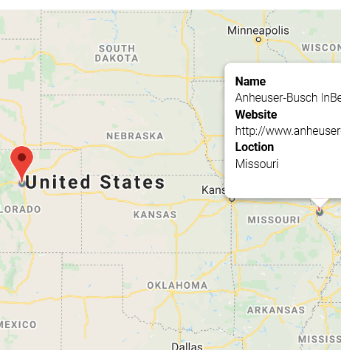
API Query to Mapping Process
Queried breweryDB API
Cleaned data with no Latitude and Longitude
Marked using latitude and longitude
Heatmap on rating
Pinned on Brewery Name and Website

Slide 8
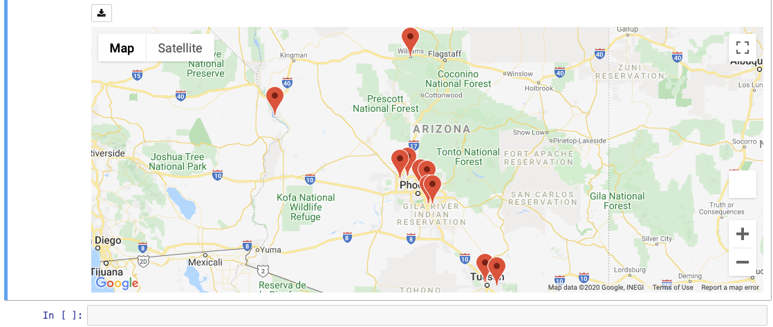
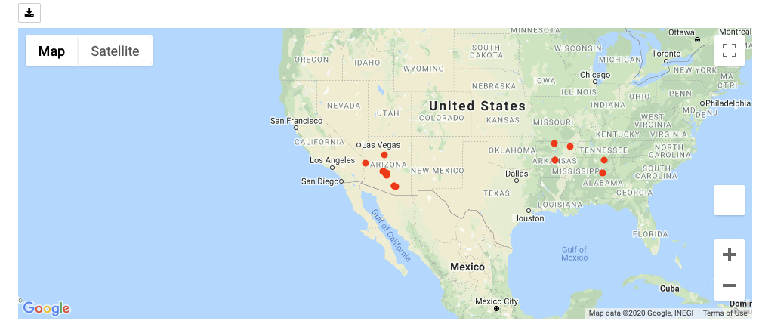
Jupyter GMAP features used
Map type – terrain, satellite
Symbol layer
Marker Layer

Slide 9
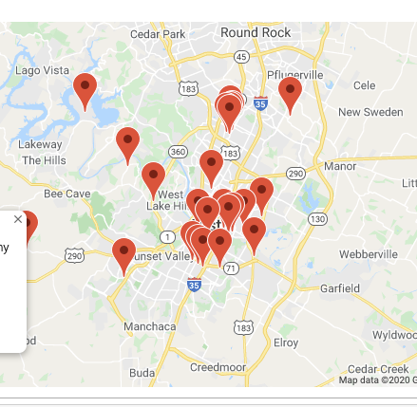
Jupyter GMAP Centering Challenge
Centering for map results display
Took average of Latitudes and Longitudes of results to plot and centered the map on the mean coordinates.

Slide 10
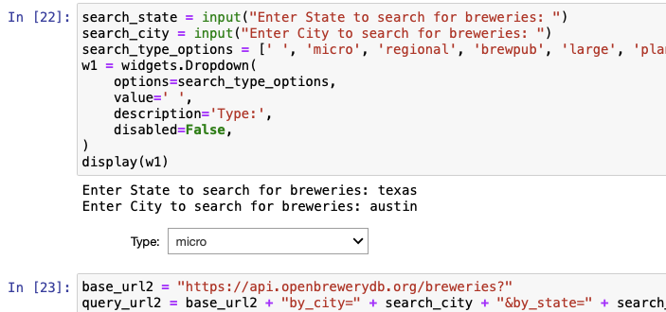
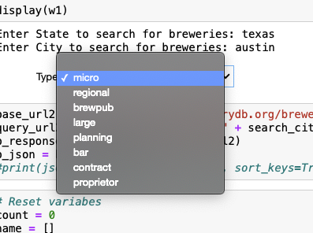
Jupyter pandas WIDGETS
Drop-down menus
import ipywidgets as widgets

Slide 11
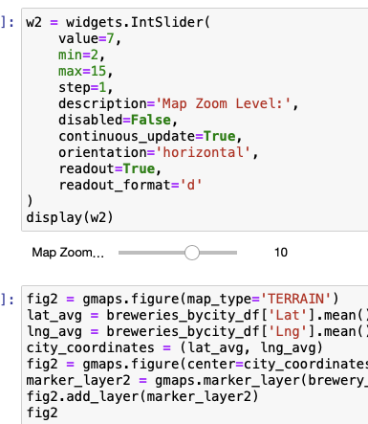
Jupyter pandas WIDGETS [Cont’d]
Sliders for map zoom
import ipywidgets as widgets

Slide 12
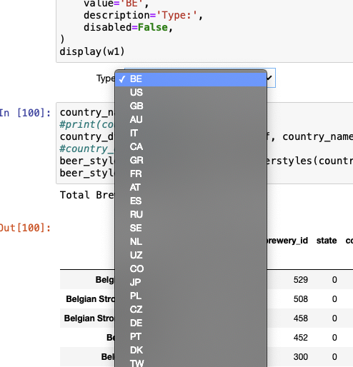
Jupyter matplotlib
Retrieved country list from global breweries data and
Loaded them into a list for drop-down selection so we
Can run report on top brew style by country
Used functions to get top brew styles and plot for each country
American IPA was surprisingly most common in many countries
Except in Germany and Belgium which makes sense given their
history in brewing.
What country would you like to look at?

Slide 13
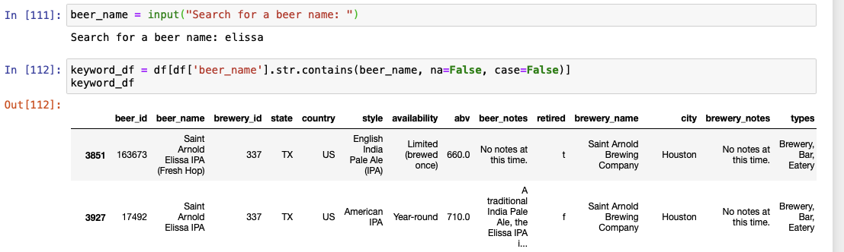
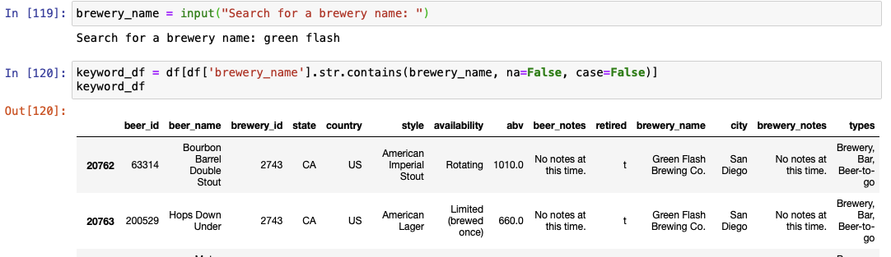
Search beer name or brewery
What beer/brewery name would you like to search for?

Slide 14
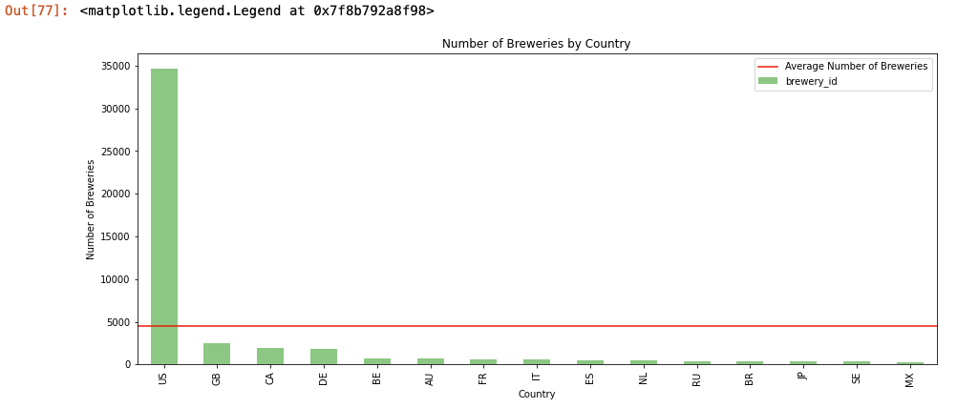
Brewery Bar Plot By Country (matplotlib)

Slide 15
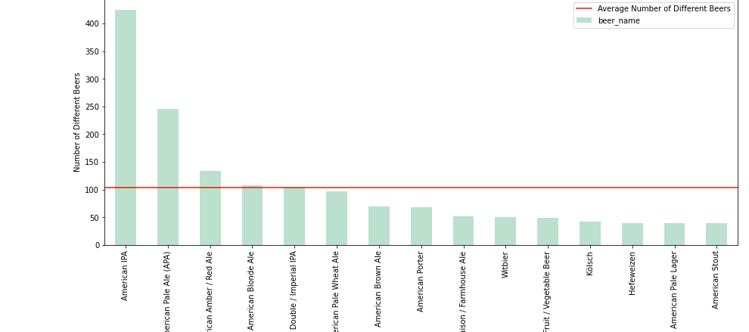
Popular Beer Styles in US

Slide 16
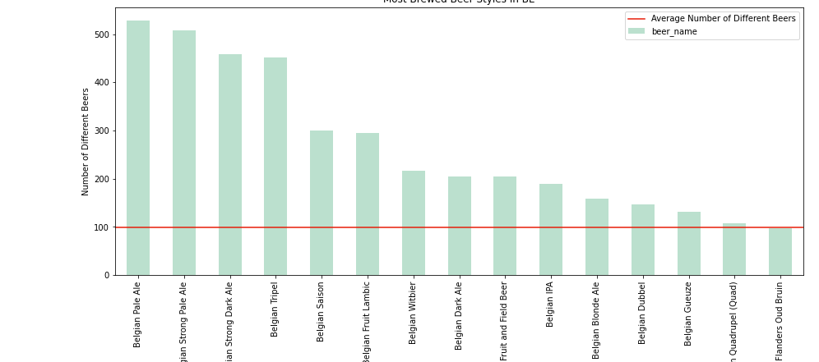
Popular Beer Styles in Belgium

Slide 17
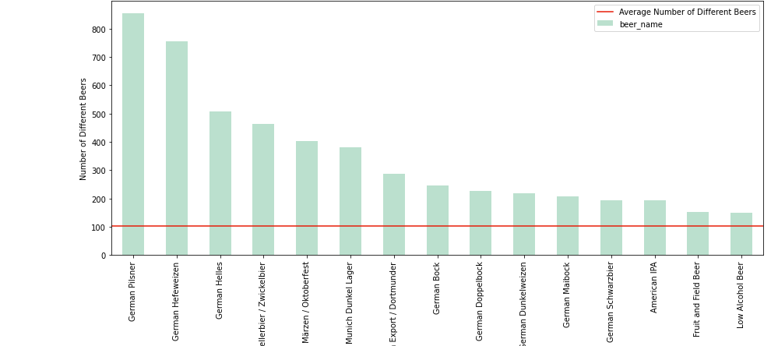
Popular Beer Styles in Germany

Slide 18
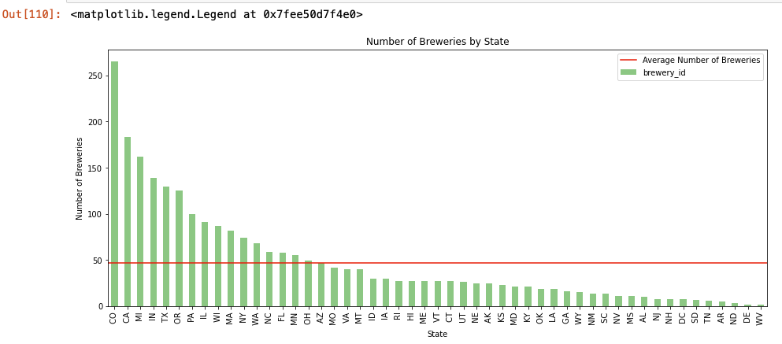
Number of Breweries By US States - 2019

Slide 19
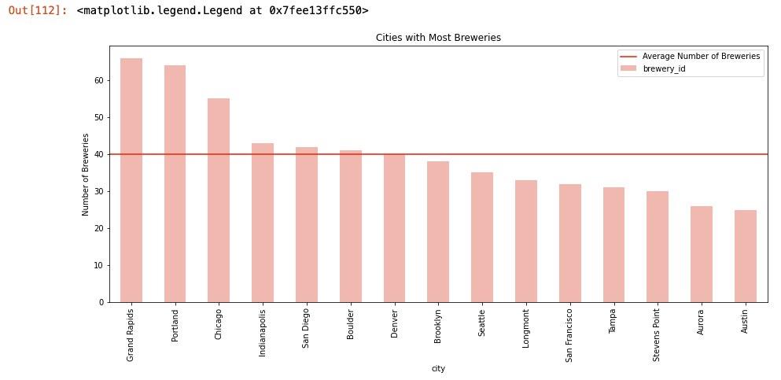
US Cities With Most Breweries

Slide 20
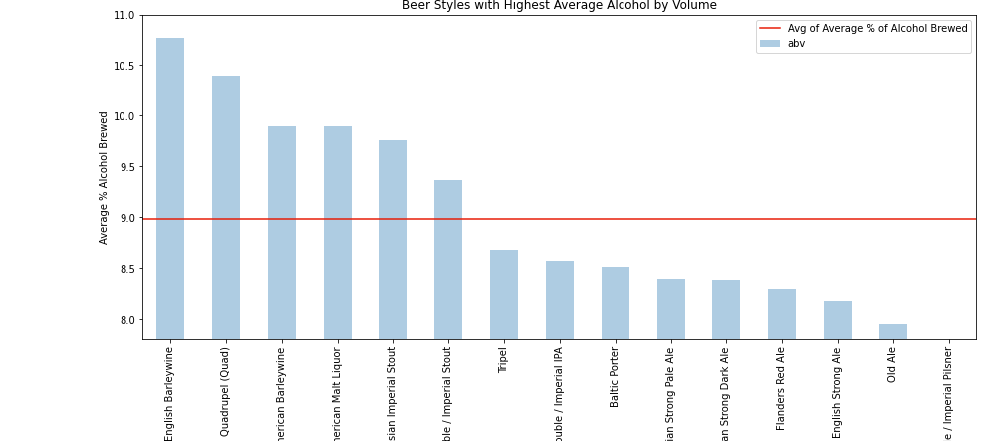
Beer with Highest ABV – IPA further down the list

Slide 21
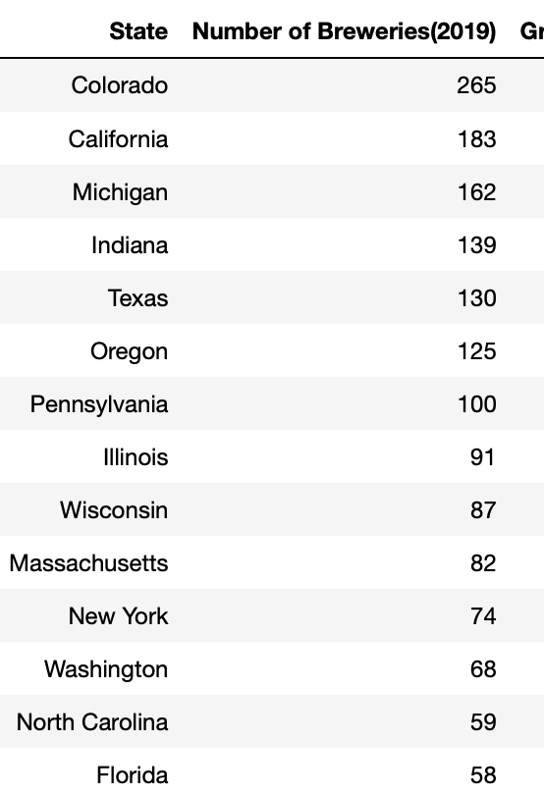
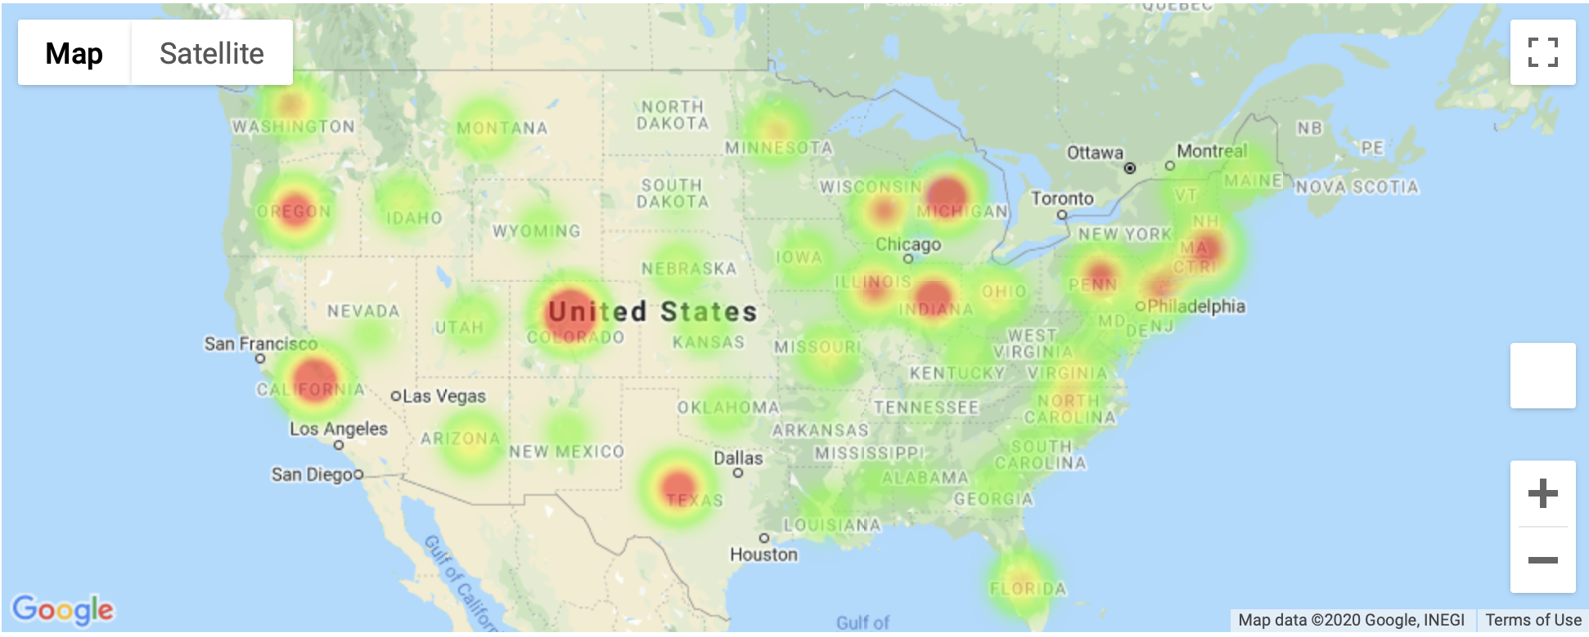
US – Num of Breweries by State (2019)

Slide 22
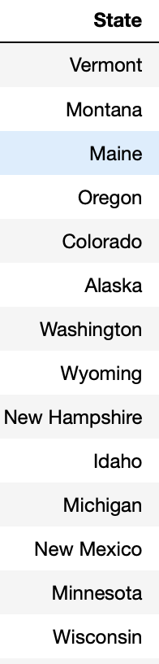
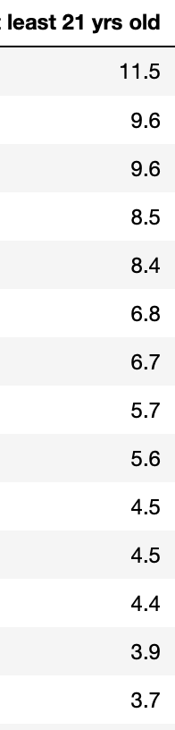
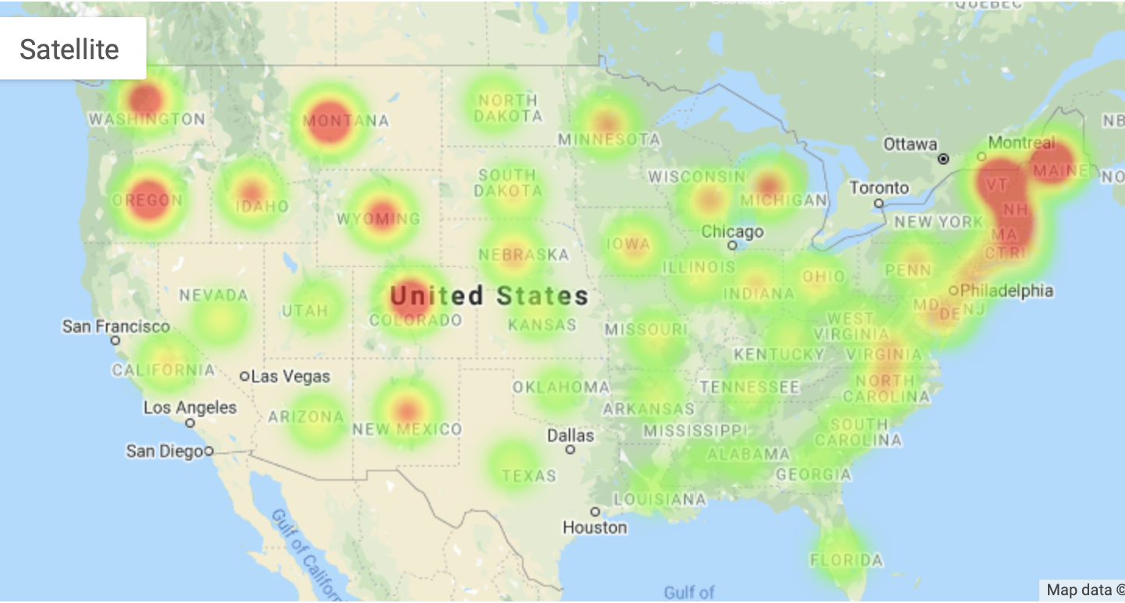
US – Num of Breweries by State per capita( 100,000 residents over age 21) (2019)

Slide 23
Results (2019)
US dominates global market and hence global results are skewed if US data is included.
IPA shows to be the most consumed style globally but not in every country. Belgium and Germany owing to their history in beer making have their own popular types in those countries.
IPA does not have the highest Alcohol By Volume (ABV) and International Bitterness Unit (IBU) [flavor] data was quite flawed/missing to give us any results.
In US, CO leads in terms of number of breweries per State.
In US, Vermont leads in terms of number of breweries per capita (per 100,000 people over age of 21).
Lack of public access to global production volumes other than summarized reports on various websites.

Slide 24
Other Summary Observations
Global Beer Consumption – top 4
China 22.4%
US 13%
Brazil 6.8%
Germany 8.4%
Global Beer Production - top 4 follows consumption except Mexico produces more beer than Germany

Slide 25
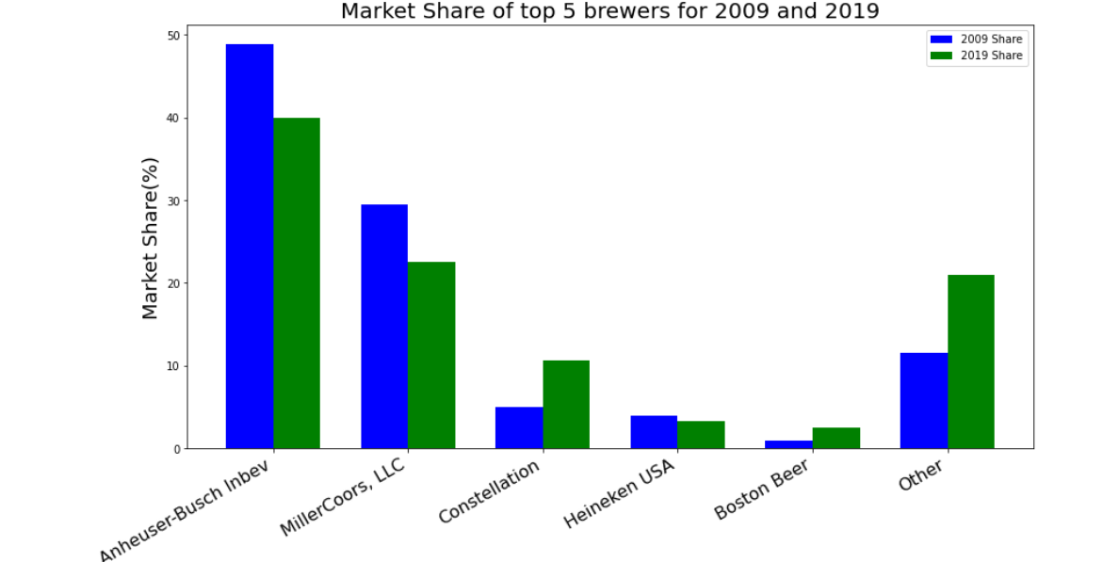
Market Share of Top 5 US Brewers (80%)

Slide 26
Top 15 Beer brands in US (2019)
Brand US dollars (Million)
Blue Moon 118.2
Sam Adams 71.4
Sierra Nevada 64.4
Lagunitas 58.7
New Belgium 44.6
Shiner 39.8
Leinenkugel’s 37.8
Shock Top 30.4
Goose Island 28.1
Sweetwater 25.5
Elysian 24.1
New Glarus 19.8
Bell's 18.9
Founders 18
Stone 15

Slide 27
Top 15 Craft Breweries in US (2019)
Rank Brewery Name City State
1 D.G. Yuengling and Son Inc Pottsville PA
2 Boston Beer Co Boston MA
3 Sierra Nevada Brewing Co Chico CA
4 New Belgium Brewing Co Fort Collins, San Francisco CO, CA
5 Duvel Moortgat Paso Robles, Kansas City, Cooperstown CA, MO, NY
6 Gambrinus Berkeley, Portland, Shiner CA, OR, TX
7 Bell’s Brewery Inc. Comstock MI
CANarchy Longmont, Tampa, Salt Lake City, Comstock, Inglewood, Dallas
CO, FL, UT, MI, CA, TX
9 Stone Brewing Escondido CA
10 Artisanal Brewing Ventures Downingtown, Lakewood, Brooklyn PA, NY, NY
11 Deschutes Brewery Bend OR
12 Brooklyn Brewery Brooklyn NY
13 Dogfish Head Craft Brewery Milton DE
14 SweetWater Brewing Co Atlanta GA
15 New Glarus Brewing Co New Glarus WI

Slide 28
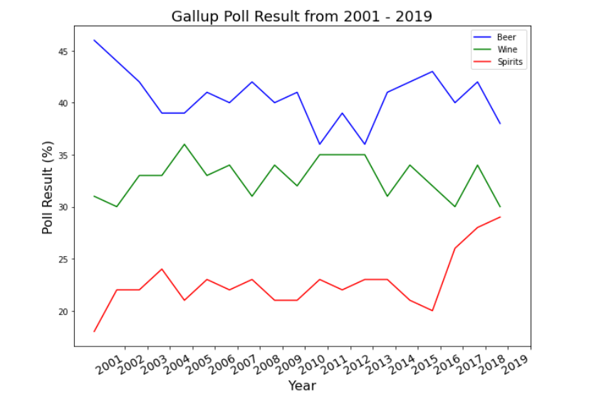
Alcoholic beverage type preference (Gallup Poll)

Slide 29
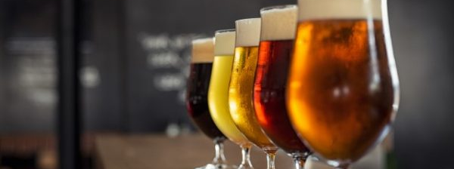
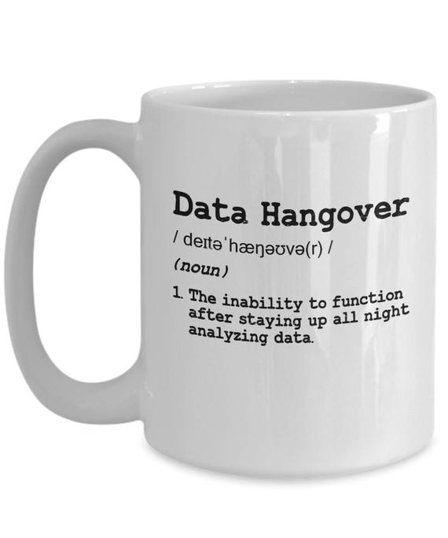

Areas of Improvement
Data sources
Data Integration
More insight from statistics
Git branching for teamwork

Slide 30
Future Project Enhancements
Include Wineries
Include ingredient analysis
Include “Images”
Alcohol vs Disorders/DUIs/Deaths

